Slide 1

Lecture 10: Programmed IO, Interrupt Driven IO and DMA
I hear and I forget. I see and I remember. I do and I understand
1

Slide 2
Previous lecture: Memory Mapped Inputs and Outputs and Simple Peripherals

Slide 3










Programmed I/O
Our examples used programmed I/O
Programmed I/O: a program running on the processor explicitly moves data to/from the device using instructions
Either interrupts or polling are used to discover when devices are ready
Memory
buffer
Processor
On-chip
program
device
cache
Bus
Processor grabs data from device and copies to buffer “by hand” (manually)

Slide 4
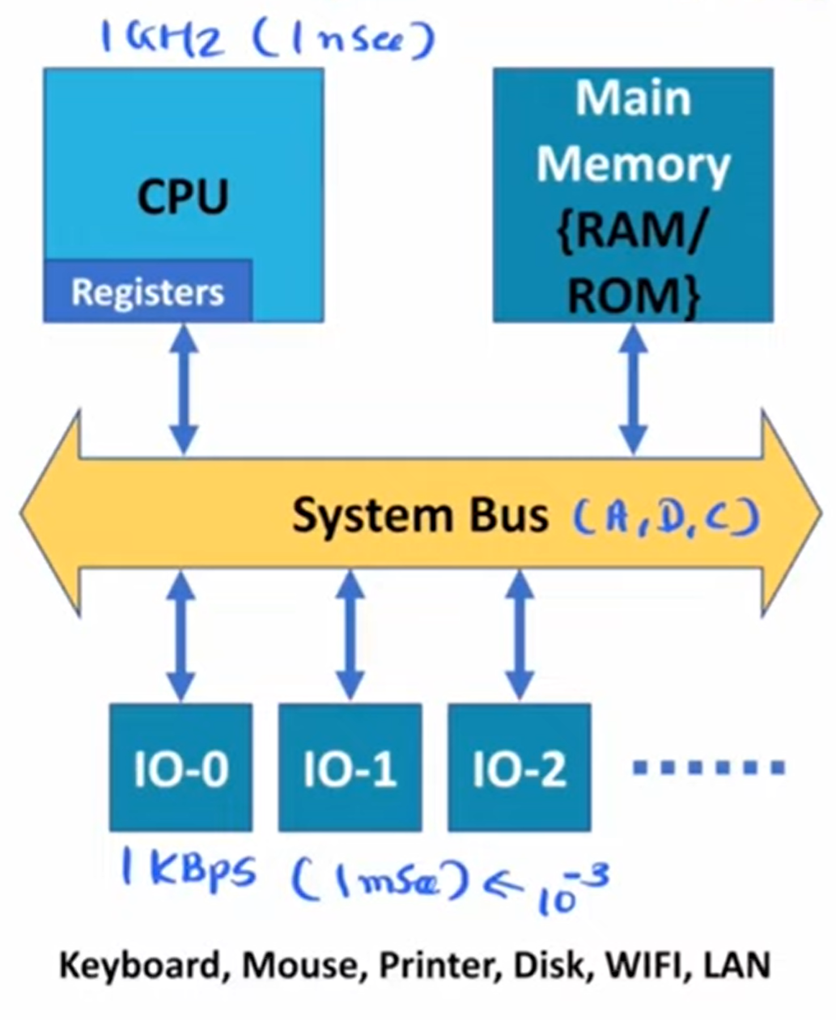
Programmed IO

Slide 5
Interrupt Driven IO

Slide 6
Interrupt Driven IO
In ARM architecture, Interrupt-Driven I/O (Input/Output) refers to a mechanism where the processor is interrupted to handle I/O operations rather than continuously polling for I/O events.
This approach allows the processor to perform other tasks while waiting for I/O operations to complete, improving overall system efficiency.

Slide 7
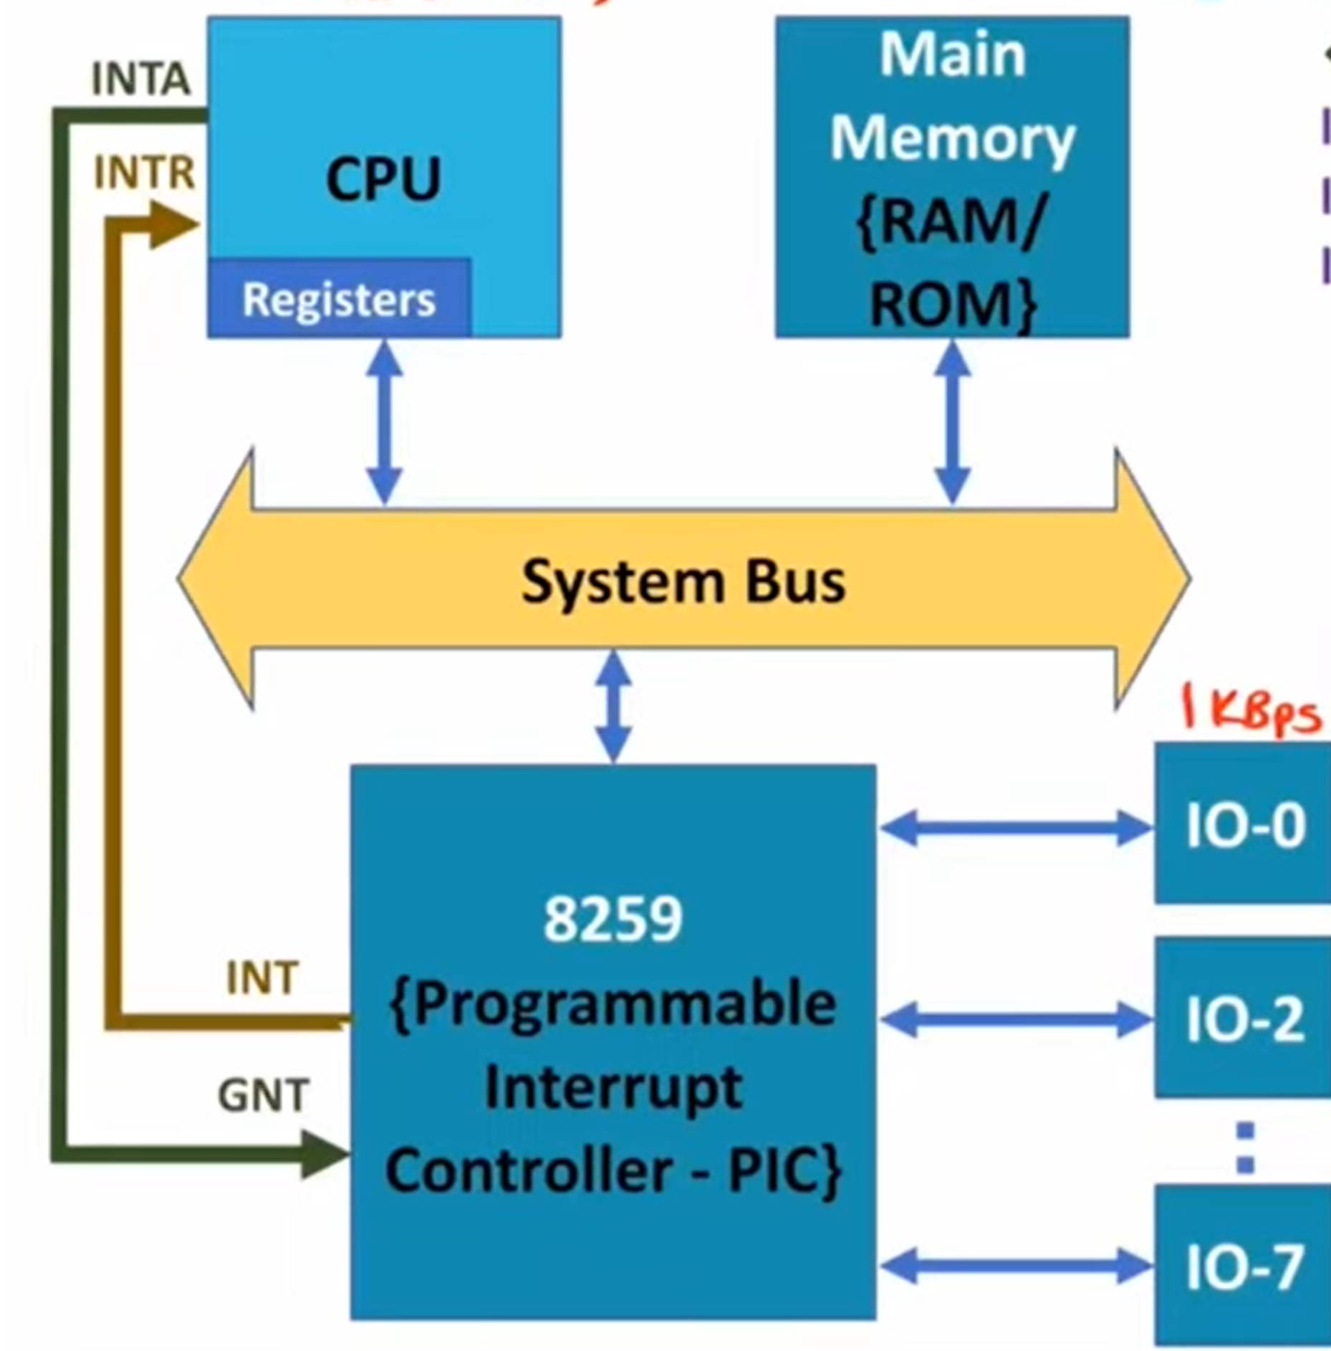
Interrupt Driven IO

Slide 8
DIRECT MEMORY ACCESS

Slide 9








Direct Memory Access (DMA)
What if we make the device a little smarter??
Make the device capable of moving data to/from memory itself
Advantage: it would no longer need the processor to move the data
Disadvantage: more complicated
DMA reads/writes memory..
Memory
buffer
Processor
On-chip
program
device
cache
Bus
... while the processor executes instructions for another process

Slide 10
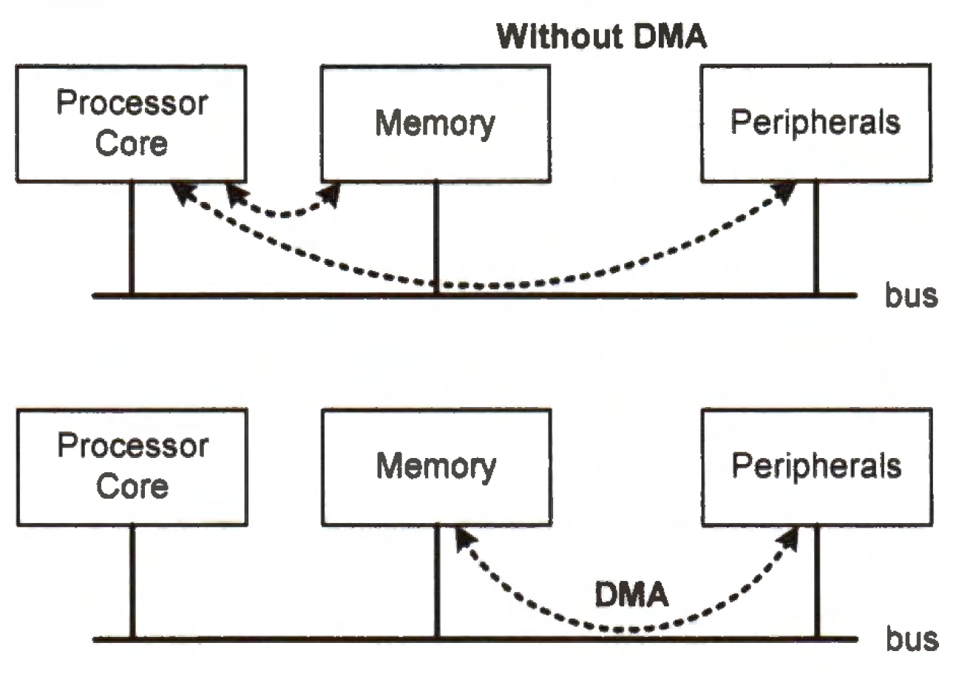
Direct Memory Access (DMA), Ch.19 P.469
Direct memory access (DMA) is a useful technique for transferring data between peripherals and memory, or between memory and memory, without using many processor cycles.

Slide 11
Direct Memory Access (DMA), Cont’
For slow peripherals, DMA releases the processor from waiting for peripheral data and allows the CPU to serve other tasks.
• For fast peripherals, such as ADC and DAC, DMA improves the data transfer throughput because memory accesses take place without the involvement of the processor.
• For high-speed peripherals, DMA can help significantly reduce the rate at which interrupts are generated. Thus, DMA decreases the performance overhead from interrupts.

Slide 12
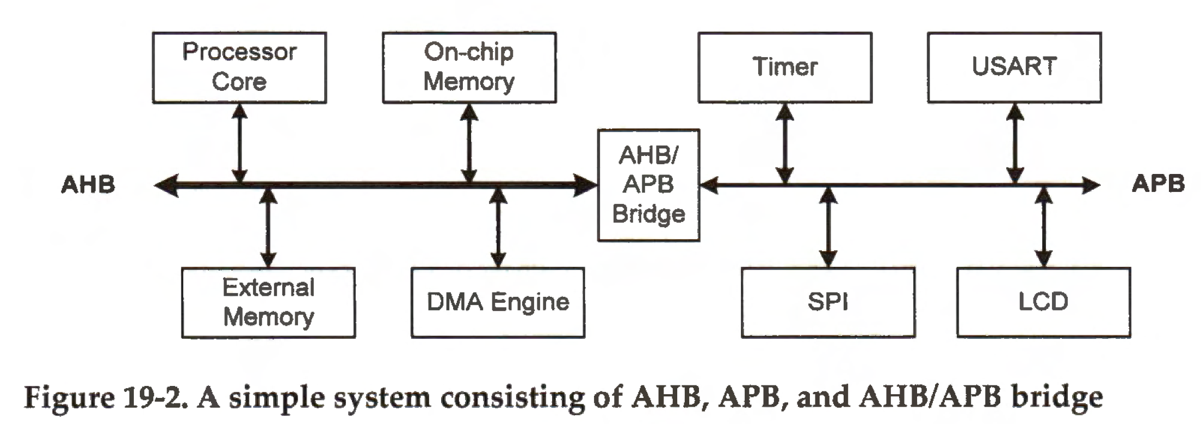
Advanced Microcontroller Bus Architecture (AMBA)
The Advanced Microcontroller Bus Architecture (AMBA) is an open on-chip communication standard for embedded microcontrollers.
AMBA 2.0 specifies the architecture and communication protocol of three bus standards, including the Advanced High-performance Bus (AHB), the Advanced System Bus (ASB), and the Advanced Peripheral Bus (APB).

Slide 13
AHB supports wider data transfer and has a higher bandwidth than ASB. AHB is used on ARM Cortex-M microprocessors.
The APB is a simple, low-power, and low-bandwidth bus that is suitable for low-speed peripherals such as timers, USART, SPI, and LCD.
These peripherals typically use memory-mapped registers to provide a simplified interface.
DMA controllers reside on the AHB bus. A DMA controller acts as a bus master and a bus slave.
The slave port can accept data and commands from the processor when the processor sets up DMA transfers
The master port can initiate data transfer within the AHB bus or across the AHB/APB bridge.

Slide 14
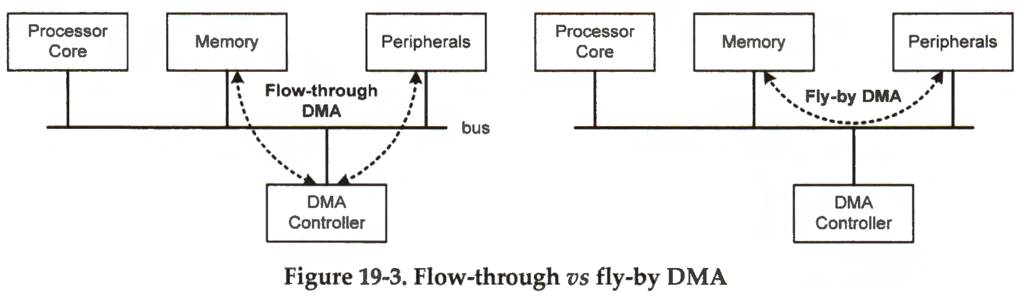

Slide 15
DMA transfers can be either flow-through or fly-by
A flow-through (or fetch-and-deposit) DMA transfer involves two steps: (1) data are read one at a time from the source into a register in the DMA controller, and (2) data are written to the destination.
A fly-by DMA transfer only requires one bus transfer. Data are directly transferred from the source to the destination without being read into the DMA controller.

Slide 16
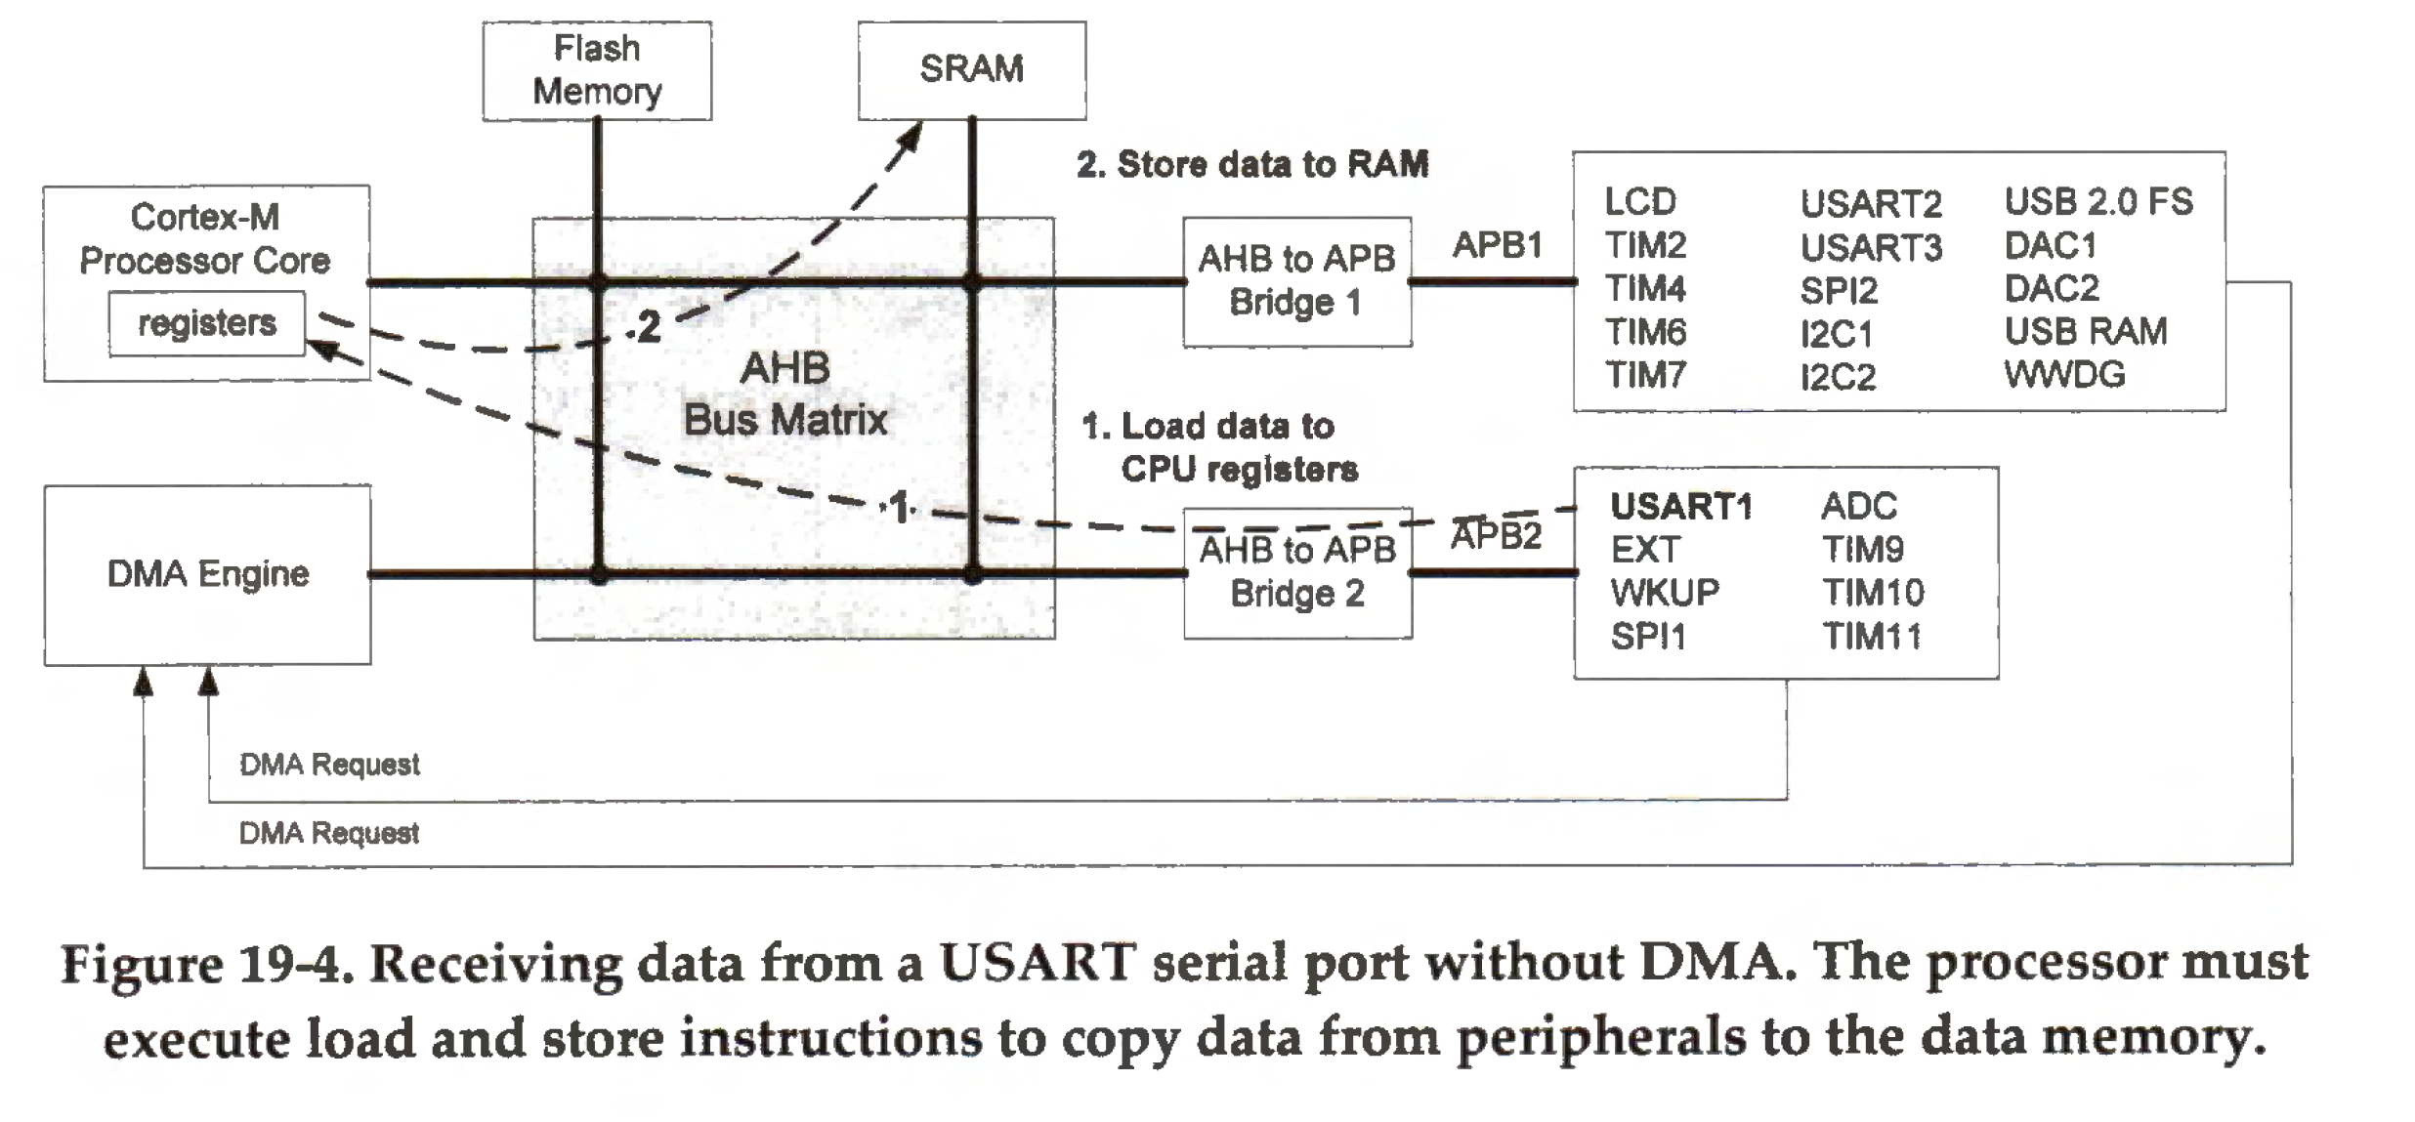
Interfacing a Peripheral without and with DMA
Without DMA, the processor is fully occupied during the data transfer.

Slide 17
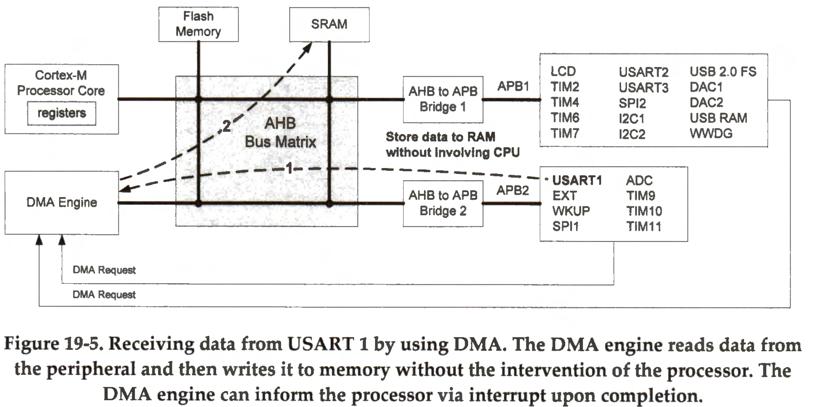
Interfacing a Peripheral without and with DMA
The processor only needs to set up the DMA transfers by programming the DMA controller and start the transfer by enabling the DMA channel. Once the transfer is in progress, the processor becomes available
for other tasks.

Slide 18
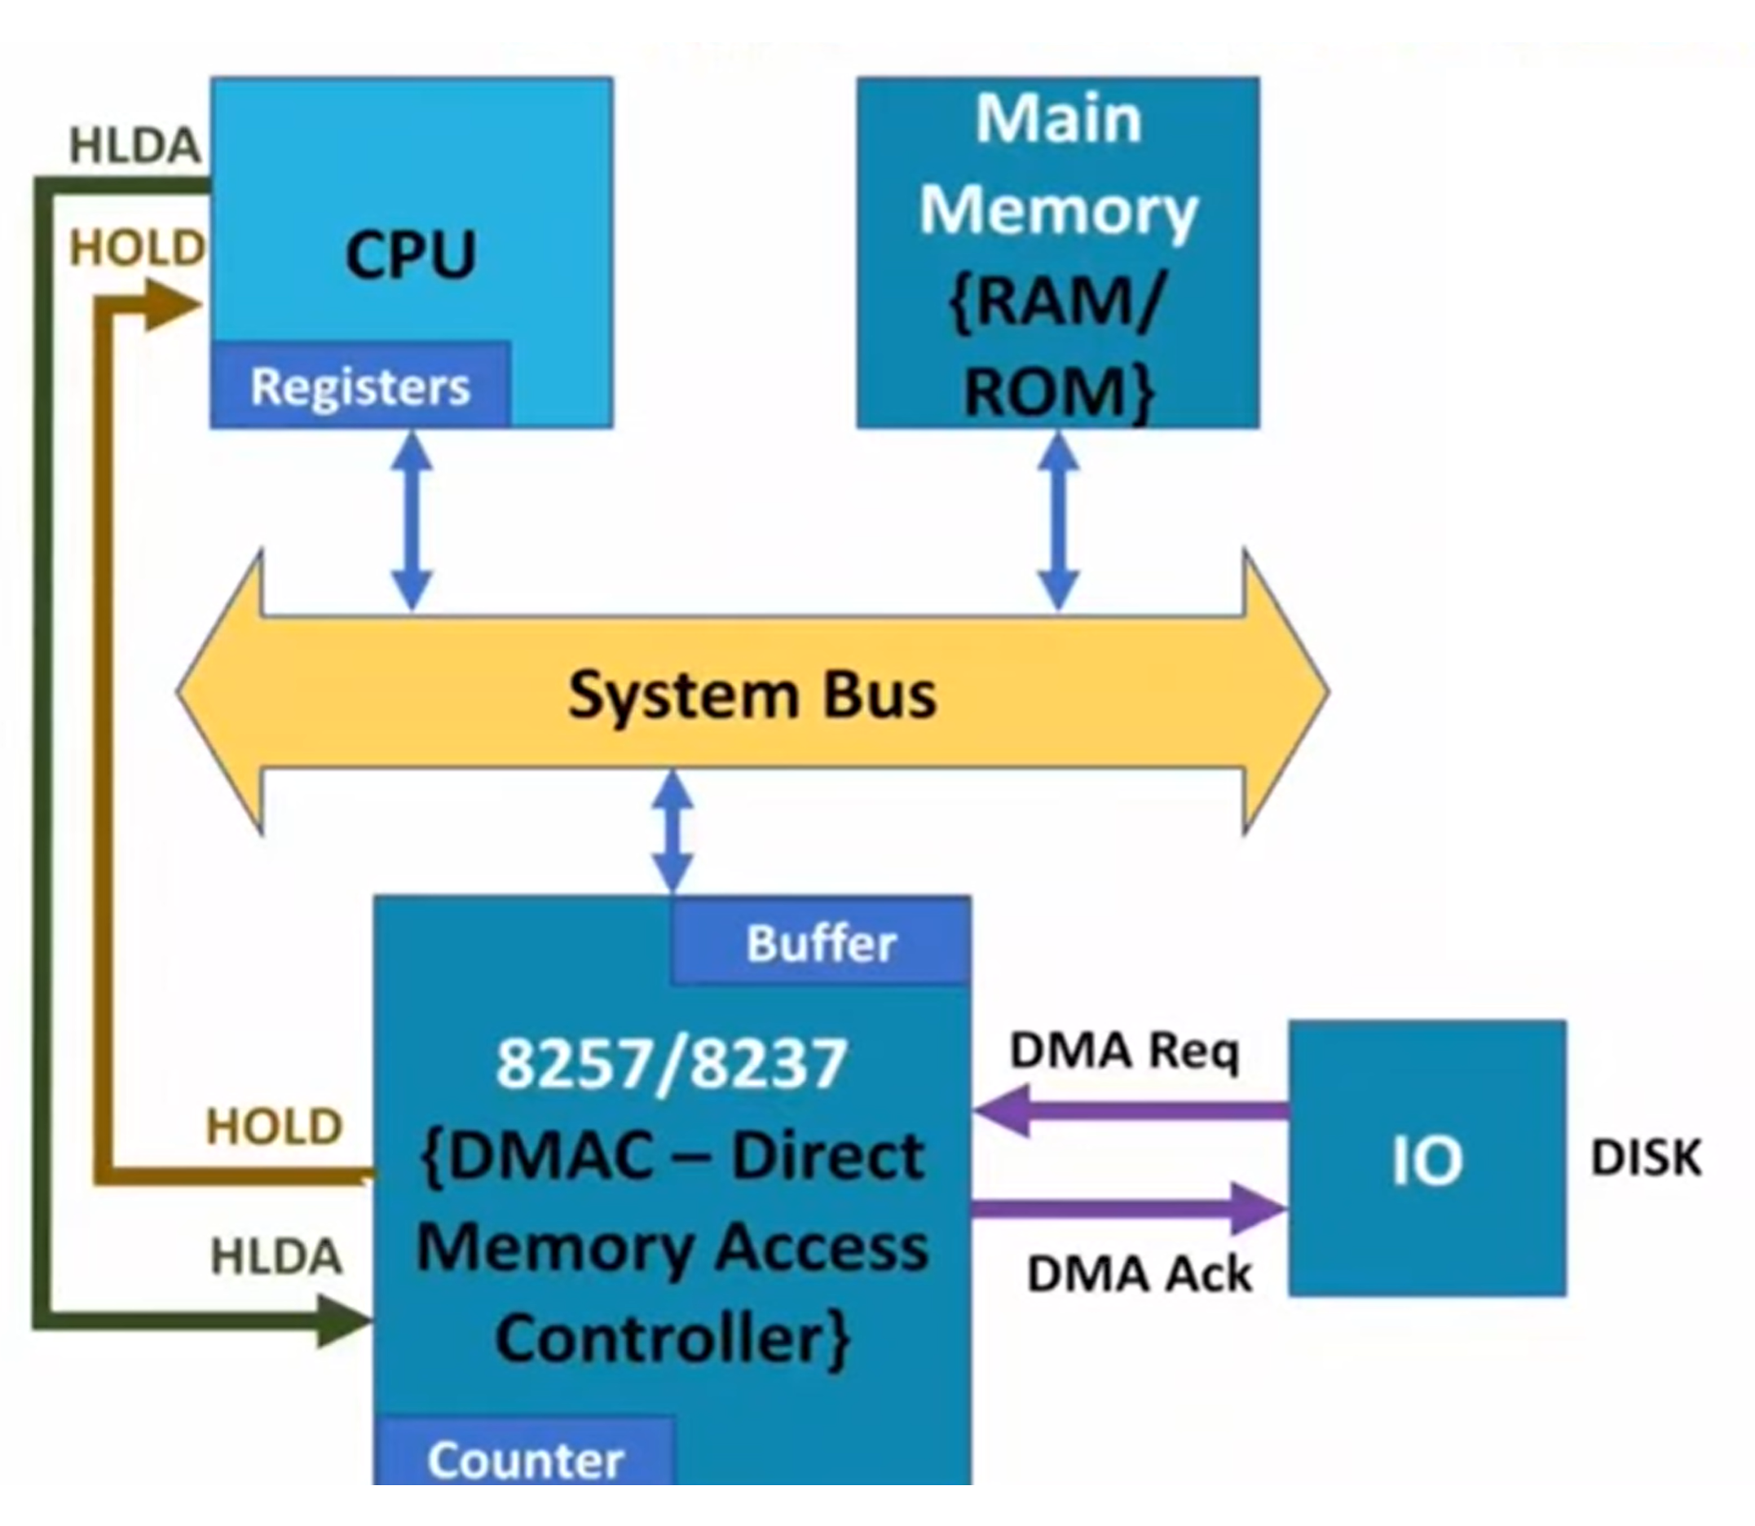
Interfacing a Peripheral without and with DMA

Slide 19
Interfacing a Peripheral without and with DMA
CPU gives I0 command at start.
{Port Number, Memory Address, Count, Control Signal}*
DMA Modes {It depends on size of buffer}
Cycle stealing: in this mode, DMA sends data in terms of byte by byte or word by word. In cycle stealing, DMAC waits till buffer is full then only for one cycle only, it takes control of system.
Burst Mode/ Batch Mode: in this mode, DMA sends data in bulk.

Slide 20
Interfacing a Peripheral without and with DMA
Timings {It depends on size of buffer}
Preparation Time: It is time to fill DMA buffer. During preparation time, CPU is free to execute other programs. During preparation time, CPU is in busy state.
Transfer Time: It is time to transfer data from DMA to Main Memory. During Transfer Time, CPU is blocked from system bus. During transfer time, CPU is in blocked state.

Slide 21
Direct Memory Access – Why?
Higher performance
Only one interrupt per N bytes moved, rather than one interrupt per byte
Stealing a cycle from the bus and doing the transfer is faster than doing a single move instruction
Each byte potentially goes over the bus fewer times
Used for high performance, block-oriented devices: disks, tapes, networks, etc.

Slide 22
DMA Channels, STM32L4
STM32L4 has two DMA controllers, each has seven channels in each.
Each channel can perform DMA transfers independently.
Each channel has its own source, destination, transfer direction, transfer width, data amount, and trigger.
If a DMA channel is enabled, it performs a DMA transfer automatically for each trigger received.
Not all triggers are available for a channel at the same time.

Slide 23
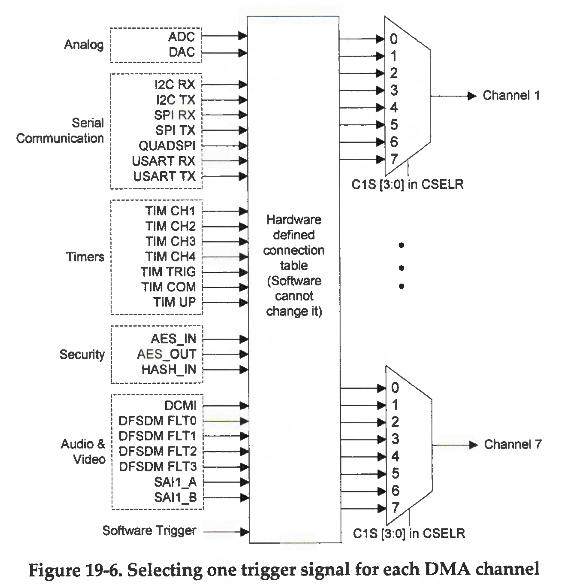
DMA Channels, STM32L4

Slide 24
Each channel has a software priority and a hardware priority. When multiple channels are active, the DMA controller uses the priority level to determine the order of bus access when a bus resource conflict occurs.

Slide 25
DMA Channels
Software priority. Programs can configure the software priority of each channel. When multiple channels are used, software should give a high priority to a channel that requires a high bandwidth, to achieve continuous data transfers and provide sustained data rates. There are four levels of priority, including very high (0b11), high (0b10), medium (0b01), and low (0b00).
Hardware priority. On STM32L4 processors, channel 1 has the highest hardware priority, and channel 7 has the lowest. Users cannot change the hardware priority of OMA channels. When multiple channels have the same software priority, the DMA engine uses their hardware priority to arbitrate the bus accesses.

Slide 26
Summary
Programmed IO
Interrupt Driven IO
DMA

